Slide 1





Using CORE for Program Assessment
Identifying Students & Courses
Winter Workshop // March 6th, 2026

Slide 2


Using Data for Assessment
Assessment leads need to identify:
  Students in degree programs being assessed
  Which of those students took specific courses
Often requires pulling data from multiple places
CORE can provide the data all in one report

Slide 3



Introducing a New Report
New CORE report designed to support selecting students
  You do not have access to the report yet, but you will soon.
Report provides:
  Student identifiers (ID/name) - No Confidential Students
  Program/degree/major (all)
  Course history within academic year
Can be used to:
  Filter to programs
  Filter to portfolio course list
  Export results for planning and artifact collection workflows

Slide 4


POWERED BY OSU IT
A Note on Access
The new report is a classified as STU3.
  STU2: Unrestricted aggregate data for internal use (e.g. number of students in the Business Administration major).
  STU3: Sensitive individual data (e.g. student class enrollment, budget details) often protected by FERPA, HEA and other regulations.
Those of you that do not have STU3 access as part of your roles will be granted a temporary (1 year) override to access this report.

Slide 5
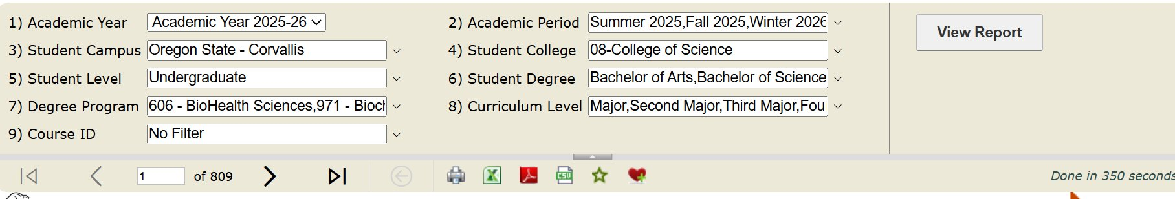
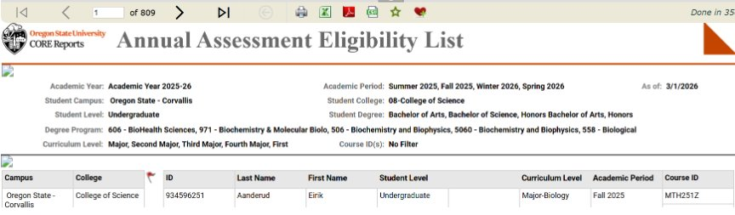
POWERED BY UIT
Running the Report

Slide 6
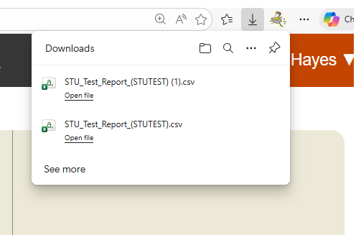
POWERED BY UIT
Exporting Results

Slide 7
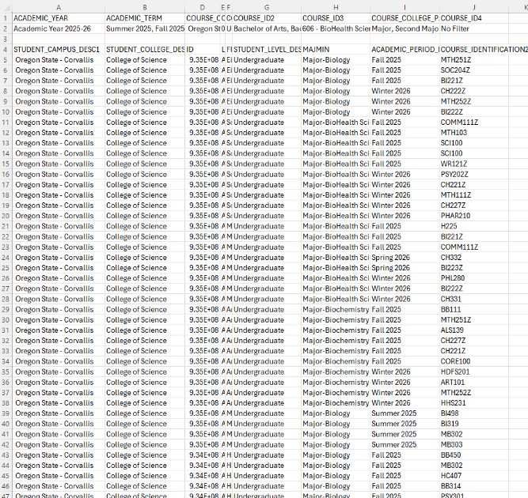
POWERED BY UIT
Exporting Results

Slide 8

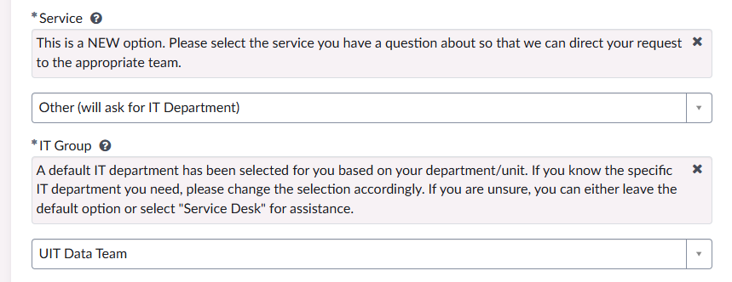
UIT is Here to Help
Data Lab
  Thursdays 11:00 -12 via Zoom
  Drop-in time for help with this dashboard or other data questions
  Data Lab
Employee Service Portal
  Use for issues with access, broken reports, unexpected results, or data discrepancies.
  Technology - I Need Something - Employee Service Portal

